Slide 1
Safety
Gloves & hair ties are available
Take care with electrical equipment & plastic tips
Shout if you spill anything

Slide 2
Equipment overview
Eppendorf tubes
Pipettes
Pipette tips
Heat block
Microfuge
Filter column
Kefir
Buffer
Enzyme
Clean-up buffers

Slide 3
Step 1: DNA extraction

Slide 4
Step 2: DNA clean up
Add 700ul DNA binding buffer to the eppendorf
Mix by pipetting up and down
Add this to the column and spin for 1 minute

Slide 5
Step 2: DNA clean up
When all the liquid has gone from the top of the column add 200ul wash buffer
Spin
Repeat add washbuffer & spin
Add 30 ul water to the column. Put it in a new eppendorf
Spin
The DNA is now in the new eppendorf

Slide 6
Step 3: DNA preparation
Add transposon
Incubate for 1 min at 30 degrees C
Incubate for 1 min at 75 degrees C

Slide 7
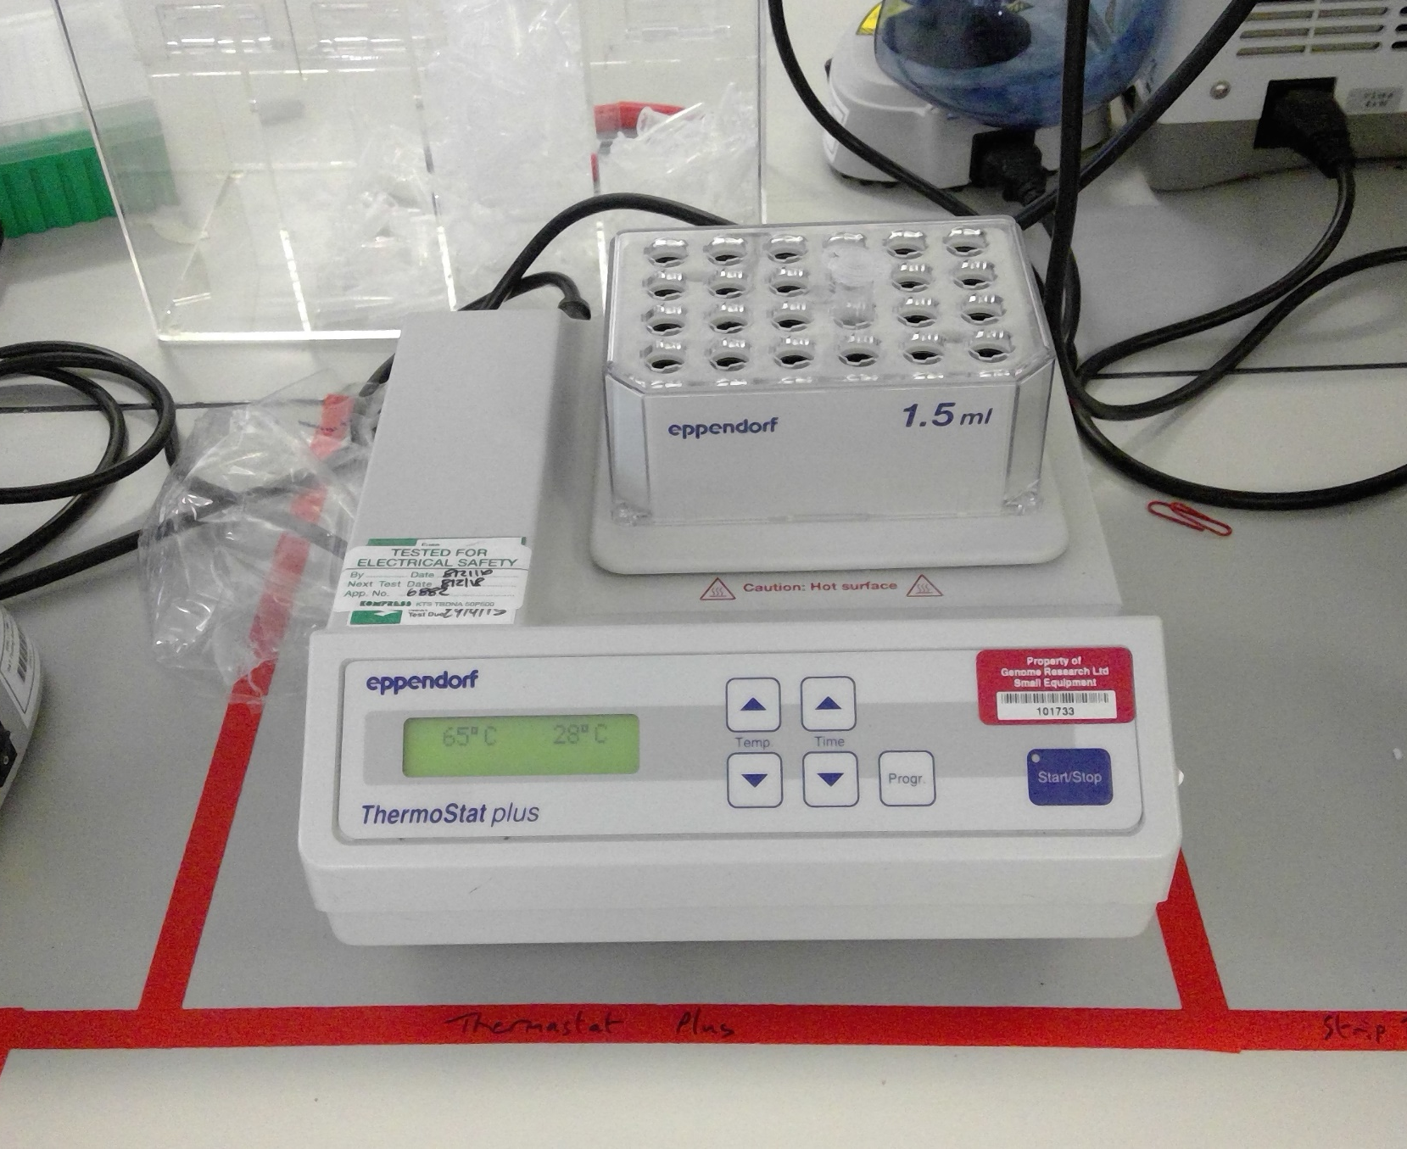

Slide 8
Step 3: DNA preparation
Add adapters and ligase
Incubate at room temperature for 5 minutes

Slide 9
Step 4: DNA sequencing
Pipette the DNA into the sequencer
Open the MinKNOW software and type in some details
Press go!

Slide 10
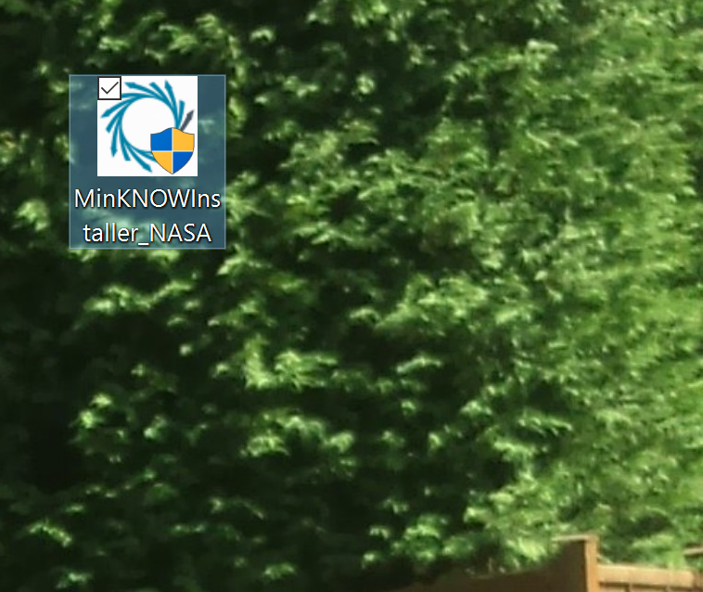

Slide 11
Step 5: Analysis
MinION data files “reads” are uploaded to the EPI2ME cloud and analysed
They’re then downloaded back to the PC
EPI2ME gives analysis output to a webpage

Slide 12
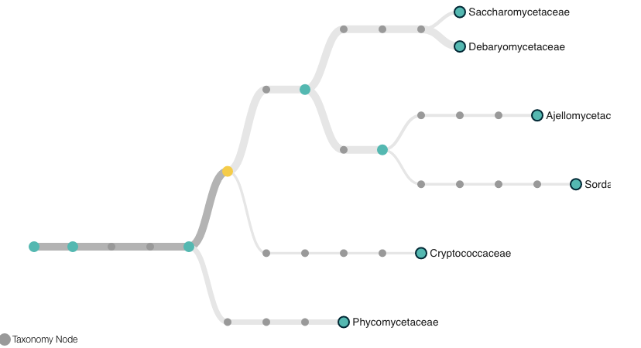

Slide 13
Where would you take a DNA sequencer?

Slide 14
What do you think we should sequence next?

Slide 15
Would you want to be sequenced?

Slide 16
When should we NOT sequence?

Slide 17
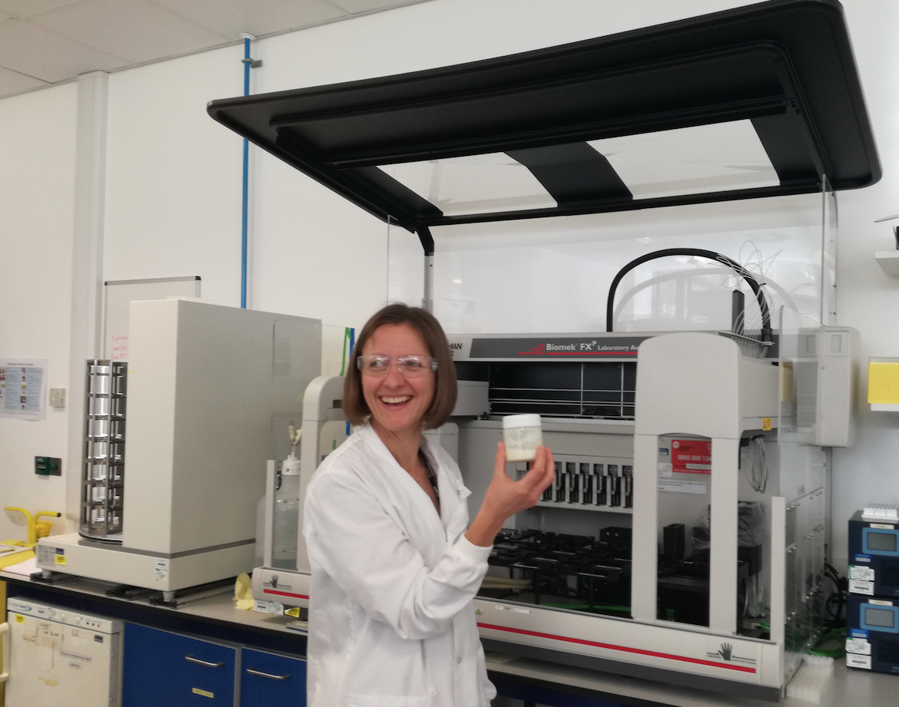
This is Naomi. She makes her own kefir

Slide 18
Summary
We lysed (broke) the cells and digested the proteins
We purified the DNA by doing a spin-column clean up
We prepared the DNA by breaking the strand and ligating (sticking) primers and a motor protein

Slide 19
Summary
We sequenced the DNA using a MinION
We built a phylogeny (family tree) using the WIMP app

Slide 20
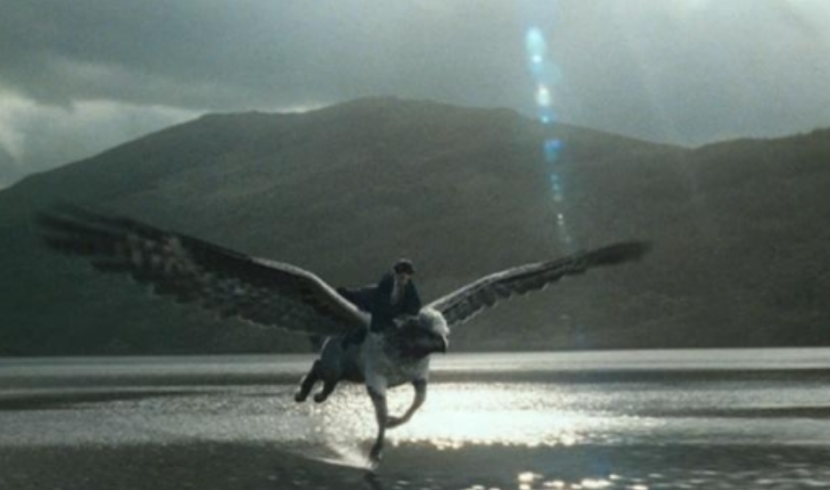


All scripts/software = open source
More available at
github.com/kim-judge/
Questions?
kj6@sanger.ac.uk
kim_judge_

Slide 21
Acknowledgements
Kerstin Goepfrich & the Naked Scientists team
Fran Gale & the WTGC public engagement team
The staff and students of the Perse School, Cambridge
Zoe McDougall, Rich Ronan & everyone at Oxford Nanopore

